Slide 1
Tree Search

Slide 2
Objectives
Two-Person Perfect Information Deterministic Game
Minimax
Pruning
Heuristic Tree Search
Evaluation function
The Problem of GO
Monte Carlo Approach
Monte Carlo Tree Search

Slide 3
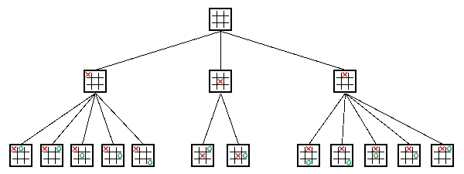
Two-Person Perfect Information Deterministic Game
MinMax is the heart of almost every computer board game
Applies to games where
players take turns
have perfect information: Chess, Checkers
Search tree
squares represent decision states (after a move)
branches are decisions ( the move)
start at root
nodes at end are leaf nodes
Levels usually called plies
a ply is one level
each ply is where "turn" switches to the other player
Players are called Min and Max

Slide 4
Tree Evaluation
Create a utility function
evaluation of game state
Max (player 1) wants to maximize the utility function
Min (player 2) wants to minimize the utility function
If a node is a final state:
assign the maximum or minimum possible utility value
depending on who would win
If a node is not a final state:
evaluate how good/bad the state is at that point
at each min node, assign the minimum of all utility values at children
at each max node, assign the maximum of all utility values at children
Push values from leaves to the top of tree
[J. Von Neumann, Zur Theorie der Gesellschaftsspiele, Math. Annalen, Vol. 100, 1928]

Slide 5
Example of Tree Evaluation

Slide 6
Complexity
Given average branching factor b, and depth m:
a complete evaluation takes time b^m
usually, we cannot evaluate the complete state
it’s too big
Game complexity:
https://en.wikipedia.org/wiki/Game_complexity
Avoid unnecessary computation
pruning
ways of determining that certain branches will not be useful
limit the depth based on various factors
time available
how to apply the utility function to not final states?

Slide 7
Minimax implementation for TicTacToe
See “notebook – minimax-tic-tac-toe.ipynb”

Slide 8
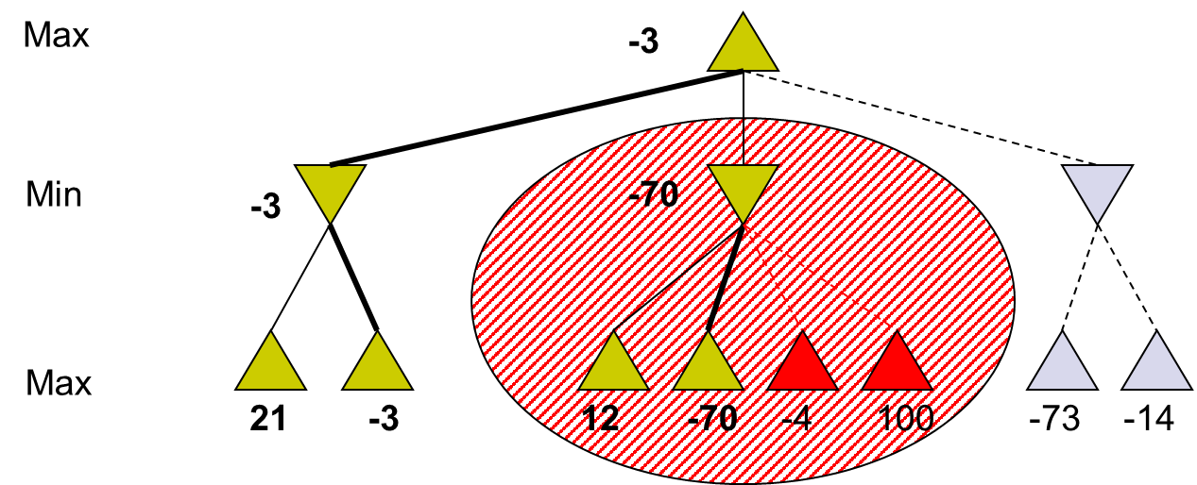
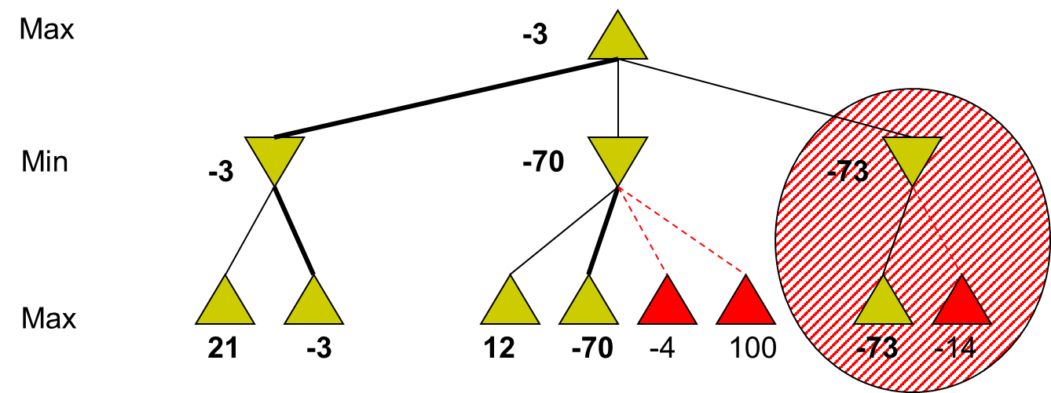
Pruning (1)
Alpha cuts
if the current max value is greater than the successor’s min value, don’t explore that min subtree anymore
beta cuts
similar idea to alpha cuts, but the other way around
if the current min value is less than the successor’s max value, don’t look down that max subtree anymore

Slide 9
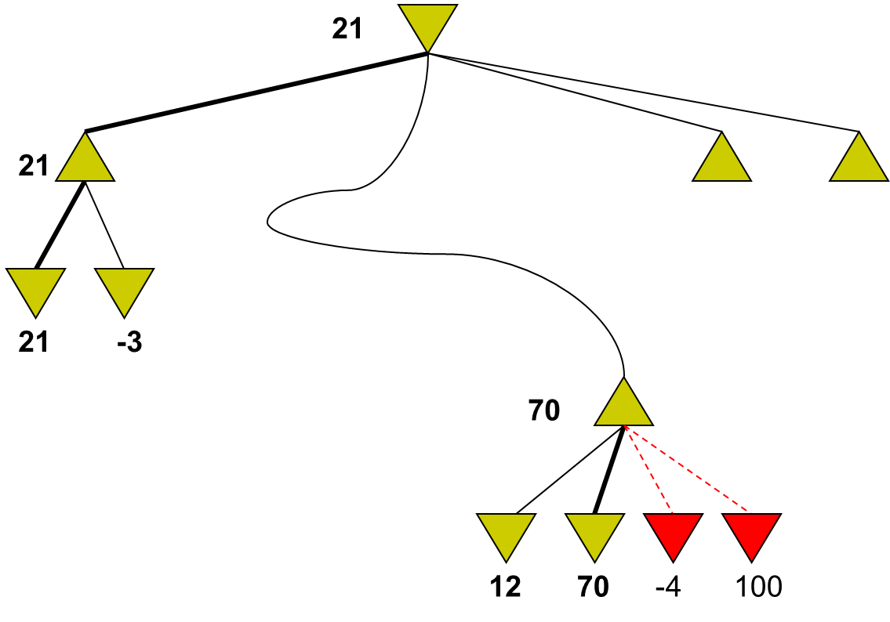
Pruning (2)
Good ordering of moves can make this pruning much more efficient
evaluating “best” branch first yields better likelihood of pruning later branches
perfect ordering reduces time to b^(m/2)
i.e. doubles the depth you can search to!
can store information along an entire path
not just at most recent levels
keep along the path:
alpha: best MAX value found on this path
initialize to most negative utility value
beta: best MIN value found on this path
initialize to most positive utility value

Slide 10
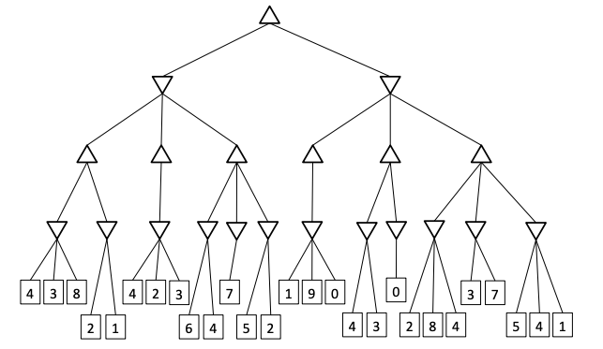
Exercise
1. Give the values, calculated by minimax for all state in the tree
2. Indicate which branches of the tree will be pruned by alpha-beta pruning

Slide 11
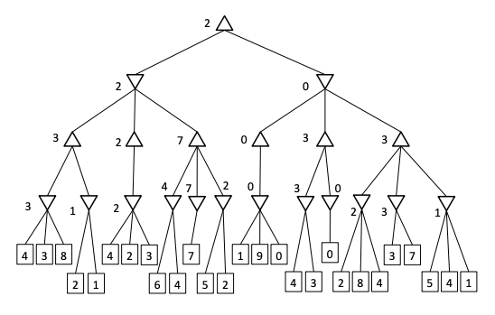
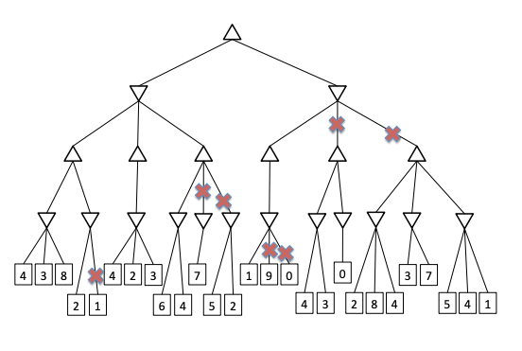
Solution

Slide 12
Utility Evaluation Function (1)
Estimate desirability of position not final
Evaluation function
assign a numerical value to a state
consider lots of individual factors
factors are combined by some function
Example for Chess:
factors:
a = # player 1’s pieces - # player 2’s pieces
b = 1 if player 1 has queen and player 2 does not, -1 if the opposite, or 0 if the same
c = etc.
linear weighted combination
u = alpha * a + beta* b + gamma* c

Slide 13
Utility Evaluation Function (2)
Quality of utility function is based on:
what features are evaluated
how those features are scored
how the scores are weighted/combined
time to calculate the function
If you had a perfect utility evaluation function, what would it mean about the Minimax tree?
you would never have to evaluate more than one level deep!
[Claude E. Shannon, Programming a computer for playing chess, Philosophical Magazine, Vol.41, No. 314, March 1950]

Slide 14
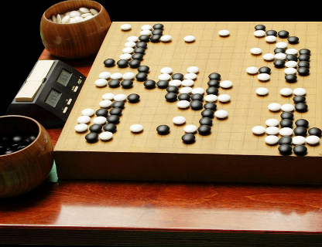
A complex example: the game of Go (1)
Go (碁) an ancient oriental board game
simple rules, rich in strategy
The game is played by two players
alternately place black and white stones on 19x19 grid
stones cannot be moved
stones can be surrounded and captured by the opponent's stones
Objective: to control (surround) a larger portion of the board
placing stones close together
helps them support each other and avoid capture
placing stones far apart
creates influence across more of the board
Strategic difficulty
finding a balance between such conflicting interests
both defensive and offensive purposes
tactical urgency vs strategic plans

Slide 15
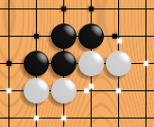
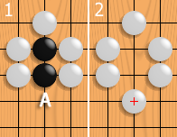
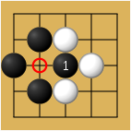
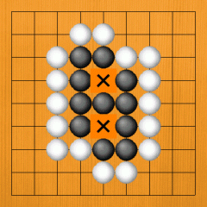
A complex example: the game of Go (2)
A vacant point adjacent to a stone is called a liberty for that stone
Vertically and horizontally adjacent stones form a chain
shares liberties
it cannot be subdivided
like a single larger stone
A chain of stones must have at least one liberty
when a chain is surrounded by opposing stones it is captured and removed from the board
A player cannot play a stone in such a way that one of his chains is left without liberties
prohibit suicide
For a group to be alive, it needs two eyes
an empty point surrounded by friendly stones
where the opponent can never play due to the suicide rule
one eye is not enough
a suicide point may be played if doing so fills the last liberty of opposing stones

Slide 16
The problem of GO
Global influence
interaction between distant stones
keeping the whole board in mind during local fights
it is possible to allow a tactical loss when it provides a strategic advantage
Tree search is not possible (complexity b^m)
TicTacToe: b=4 m=9
Chess: b=35 m=70
Go: b=250 m=150
[Bouzy, B. and Cazenave, T. (2001). Computer Go: an AI oriented survey. Artificial Intelligence, Vol. 132, pp. 39–103]

Slide 17
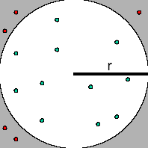
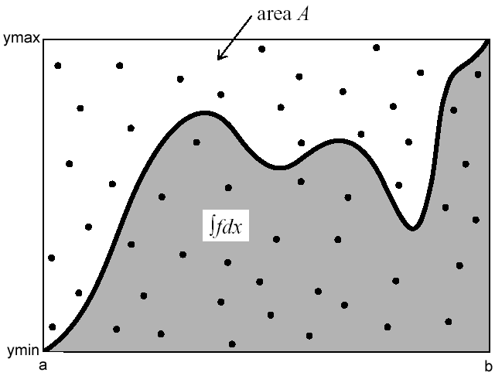
Monte Carlo Methods
A numerical method for statistical simulation which utilizes sequences of random numbers to perform the simulation
given the probability P of an event in certain conditions, a computer can be used to generate those conditions repeatedly
number of times the event occurs divided by the number of times the conditions are generated should be approximately equal to P
Classic example: find the value of PI
Area of square = (2*r)^2 = # of dots inside square
Area of circle = PI*r^2 = # of dots inside circle
PI = 4 * (area of circle / area of square)
Hit and miss algorithm
Another example: Monte Carlo integration
How to evaluates the integral of f(x) (e.g. sin(x)) from x₀ (e.g. 0) to x₁ (e.g. PI)
See “notebook - monte-carlo-integration.ipynb”

Slide 18
Monte Carlo (MC) Approach
Playing random games from a position
Inferring the value of this position from these games
Given a board position B, we aim at compute a value V(B)
starting from B, MC plays a certain number of simulated games
a succession of simulated moves
played until the end of the game is reached
V(B) is deduced from the results of all the simulated games
Simplest version
simulated moves are random moves
V(B) is the average of the outcomes of the simulated games
More advanced implementations
move-selection procedures
back-propagation strategies

Slide 19
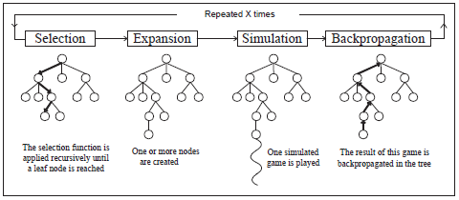
Monte Carlo Tree Search (MCTS)

Slide 20
MCTS: selection and expansion
While the state is found in the tree, the next action is chosen according to the statistics stored
balancing exploitation and exploration
often select the action that leads to the best results (exploitation)
less promising actions still can be explored (exploration)
When the game reaches a state not in the tree
the state is added as a new node
the tree is expanded by one node for each simulated game
For the rest of the game use MC
actions are selected at random until the end of the game
the action selection probabilities has a significant effect
if all legal actions are selected with equal probability the strategy played is often weak
use heuristic knowledge to give larger weights to promising actions
[Chaslot, G.-B.; Saito, J.-T.; Bouzy, B.; Uiterwijk, J.; and van den Herik, H. 2006. Monte-Carlo Strategies for Computer Go. In Proceedings of the 18th Belgian-Dutch Conference on Artificial Intelligence, 83–90]

Slide 21
MCTS: Simulation and Backpropagation
After reaching the end of the simulated game
update each tree node that was traversed
update visit counts and the win ratio according to the outcome
2/4
1
1/2
0
1
1
0
1
0

Slide 22
MCTS: Example
3/7
2/5
2/6
3/9
4/10
3/8
3/5
0
2/3
1
0/1
2/4
1/3
1/2
1/2
0/1
2/3
1/2
1
0/1
0/1
0/1
1/1

Slide 23
MCTS: balancing exploitation and exploration
For the next iteration, a node is selected with a rule:
move eval = mean + c * sqrt(log(t)/s)
t is the number of simulations of the parent node
s is the number of simulations of the node
selects the best move most of the time (mean)
also explores other moves in a more sophisticated way (sqrt(log(t)/s))
goes down every time the node has been visited
goes up a little every time the parent was visited and some other move is selected
Initially, the use of randomized simulations in classic board games was criticized by researchers
it was shown that MCTS is able to build the most powerful GO-programs!
before AlphaGo and DeepRL approach…

